Slide 1
Image Caption Generation with Enhanced Visual Attention Mechanisms (Adaptive Attention)
CS6400 Course Project by Rahul Vinay
Extended work on the Paper: Show, Attend and Tell: Neural Image Caption Generation with Visual Attention
Kelvin Xu, Jimmy Ba, Ryan Kiros, Kyunghyun Cho, Aaron Courville, Ruslan Salakhutdinov, Richard Zemel, Yoshua Bengio

Slide 2
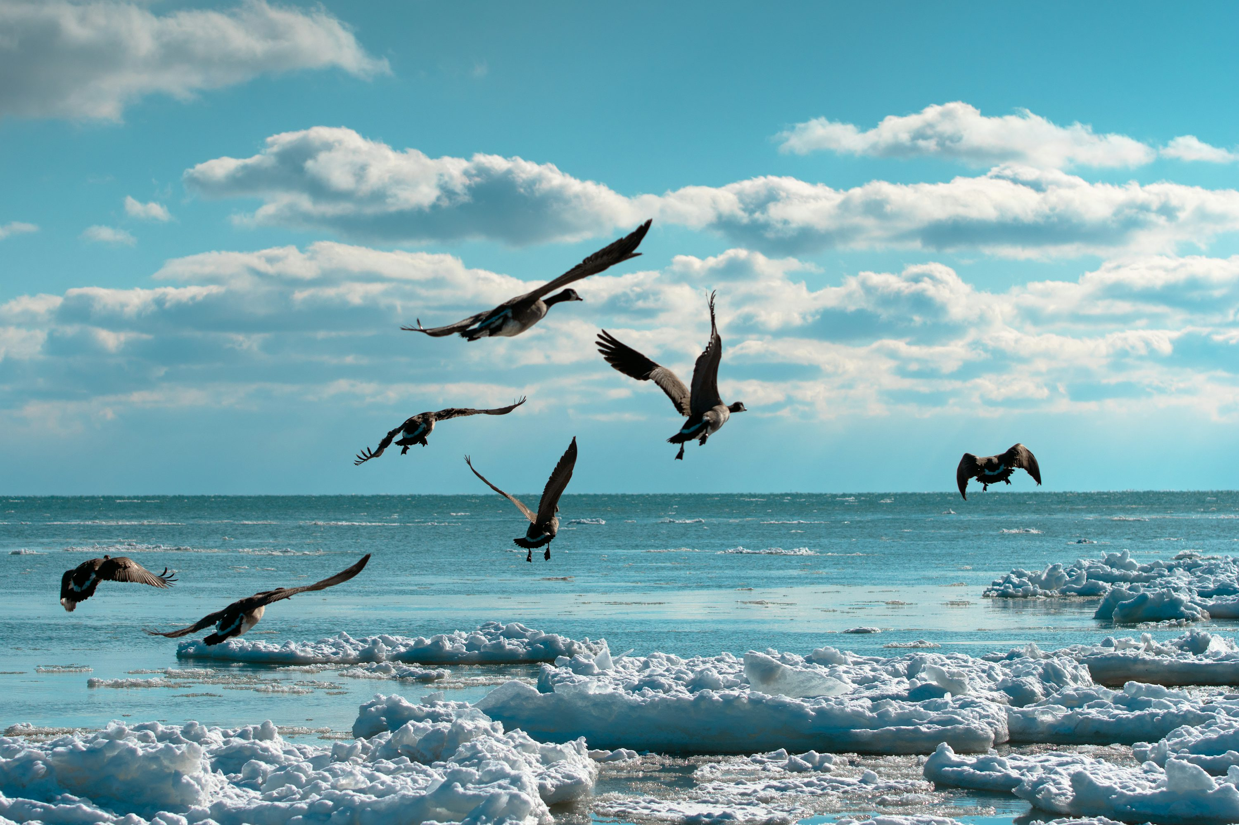
Why Image captioning?
Transforming pixels into meaningful text: Image captioning bridges vision and language, enabling better AI understanding of images
A scenic photo with flying objects
A flock of birds gracefully flying over a frozen, snow-covered shoreline with a clear blue sky and scattered clouds in the background.
(Generated by ChatGPT 4o)

Slide 3
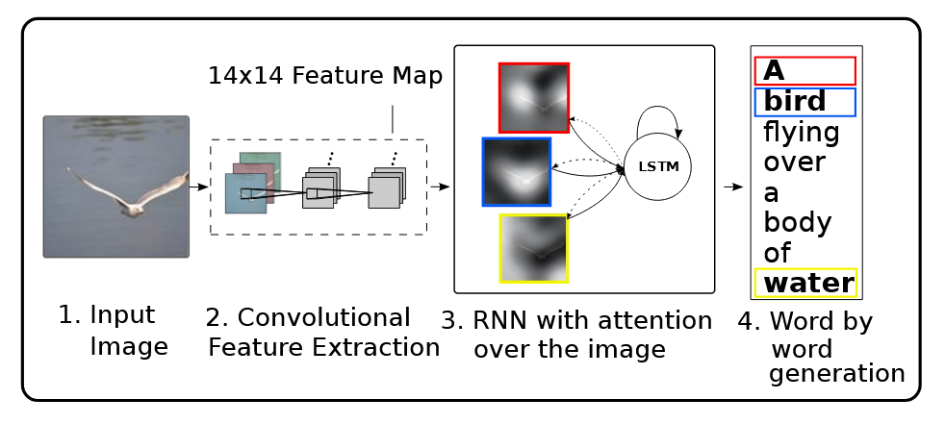
Show, Attend And Tell!
Using attention to dynamically focus on image regions while generating captions

Slide 4
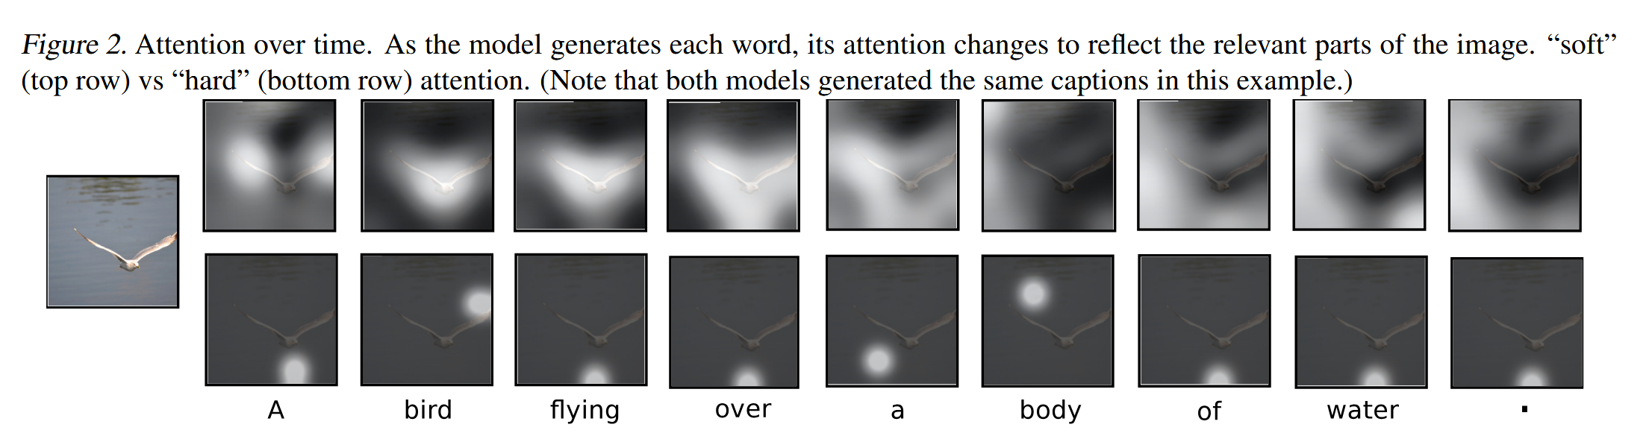
What are we trying to do?
Convolutional Neural Networks extract a 14x14 feature map from images.
Recurrent Neural Networks with attention generate captions word-by-word.
Attention mechanism helps pinpoint regions tied to each word.

Slide 5
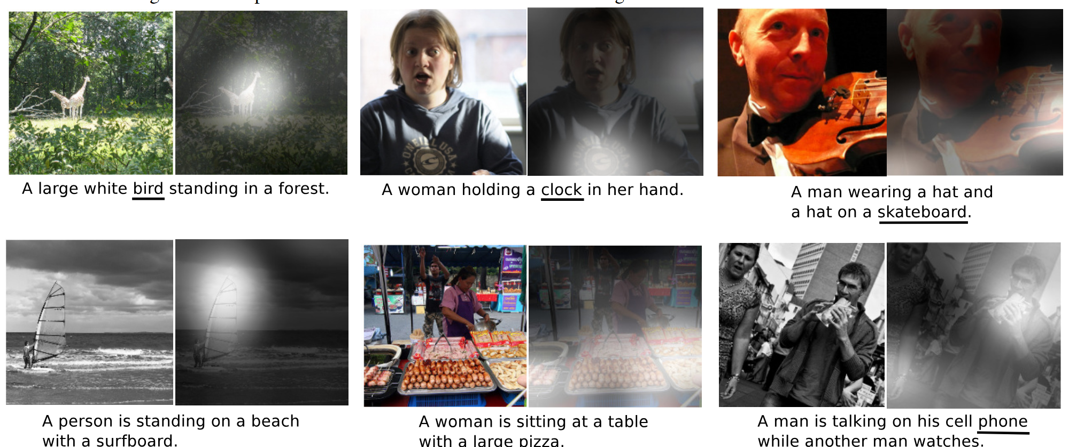

Slide 6
Limitations : Why Adaptive Attention?
Static attention can't adapt dynamically to complex image contexts.
Hard attention is computationally expensive and less efficient.
Soft attention spreads focus uniformly, missing nuanced relationships.
Why Adaptive Attention?:
Dynamically learns when to focus on image regions or language context.
Achieves a balance between quality and computational efficiency.
Captures nuanced details for more accurate captions.

Slide 7
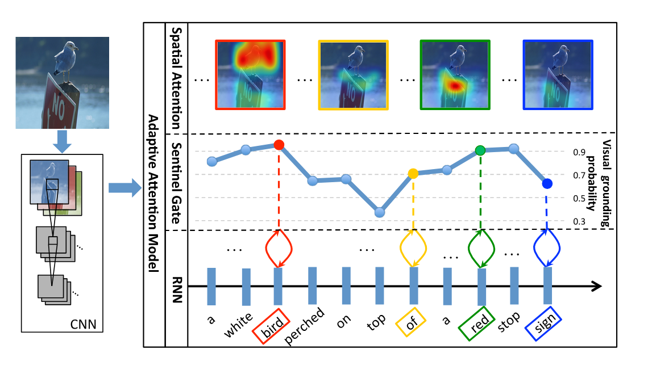
What’s Adaptive Attention? How did we implement?
Enables the model to dynamically decide whether to focus on image regions or rely on language context for each word.
Incorporates a sentinel gate to prioritize contextually relevant information.
Encoder: ResNet50 extracts 14x14 feature maps
Adaptive Attention Module
Decoder LSTM

Slide 8


Training and Data Processing Strategies
Building vocabulary:
Extracted captions from the dataset. (Flickr8k)
Tokenized captions using NLTK to split into meaningful words.
Removed special characters and converted text to lowercase for consistency.
Applied a frequency threshold of 3.
Reserved tokens: <SOS>, <EOS>, <PAD>, <UNK>.

Slide 9
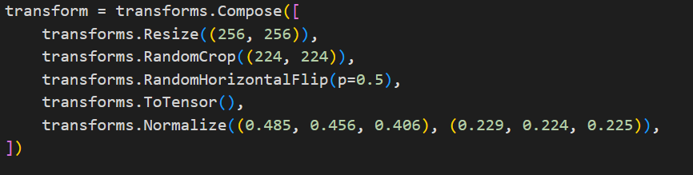
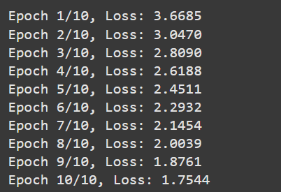
Data Augmentation
Training Techniques
Sorted captions by length in each batch.
Batch processing
Adam optimizer + lr = 0.001

Slide 10
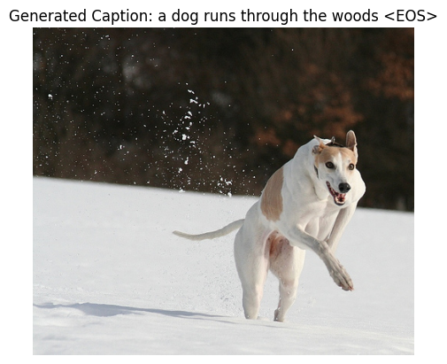
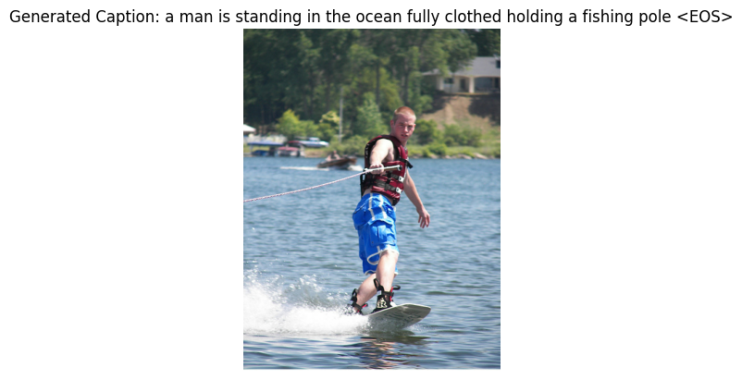
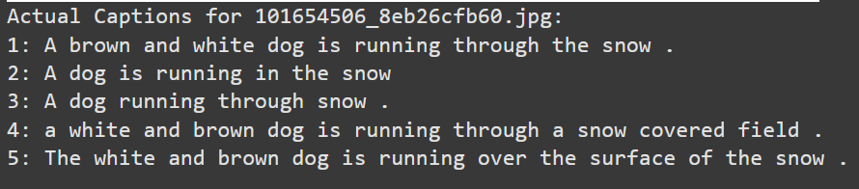
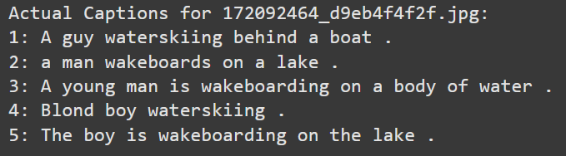
Results and Evaluation
Dataset: Flickr8k (possible extension to Flickr30k or MS COCO)

Slide 11
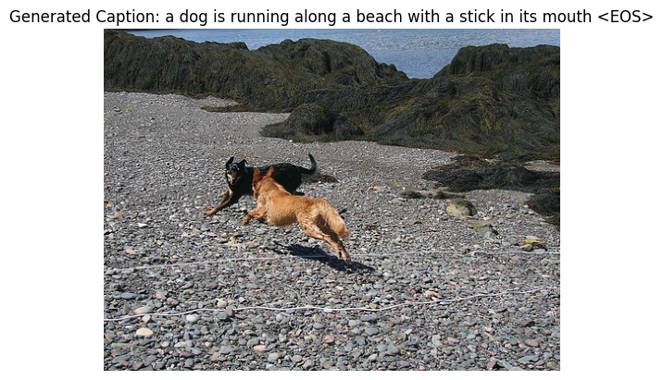
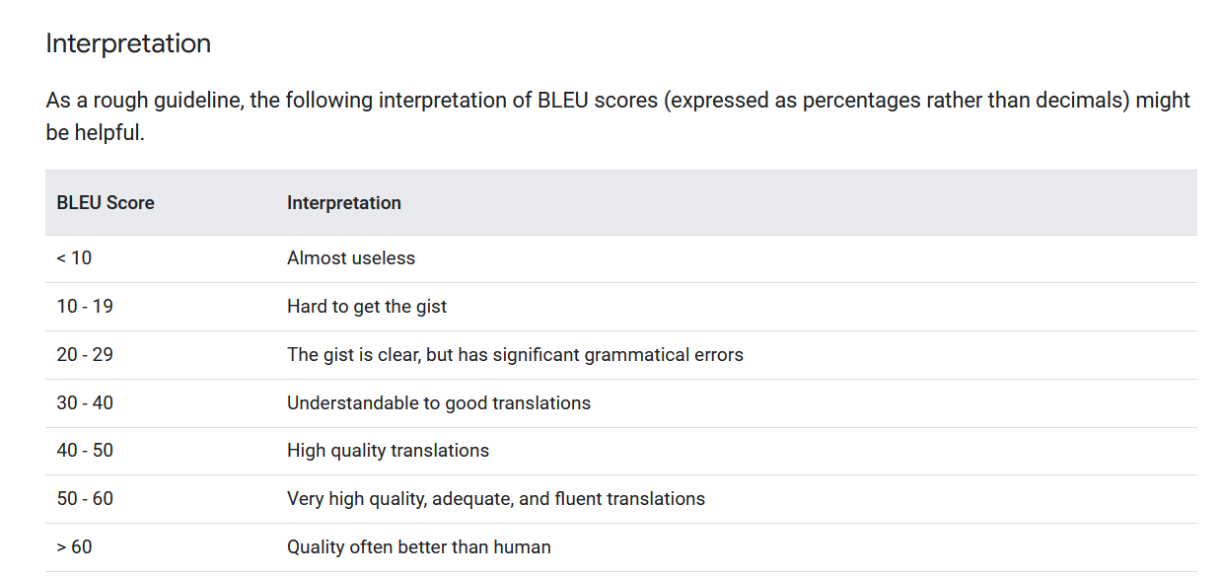
BLEU Score: ~19.5
Good starting point for Flickr8k but not good enough.
Note:
BLEU has several limitations so need to explore other metrics as well.
No contextual understanding
Insensitive to synonyms
Favors shorter sentences
Source: https://cloud.google.com/translate/docs/advanced/automl-evaluate

Slide 12
What have I learned? What next?
Learnings:
Sentinel gates improve attention but require better tuning.
Dataset size impacts performance; larger datasets are needed.
Try out other metrics and not just BLEU score.
Future Scope:
Explore positional encodings for spatial awareness.
Extend to larger datasets like Flickr30k or MS COCO
Optimize training for better BLEU scores.

Slide 13
Thank you! Questions?

